Slide 1
Program Review: Social Emotional Learning & Mental Health
May 22, 2023

Slide 2
Universal Screener
RCW 28A.320.127 requires all K-12 school districts to adopt a plan to screen, recognize and respond to indicators of social, emotional, behavioral and mental health of students
Currently administering the Student Wellness Screener (SWS) from CEE (Center of Educational Effectiveness)
Grades 3-12 take the universal screener 2x per year
Administered in Fall (November) & Spring (May)
Parent letter is sent out (with questions for review) prior to each administration and provides opt out option
Admin/Counseling Team has been researching universal SEL screeners to find a tool that better meets our needs

Slide 3
2022-23 CEE SWS Data
Spring 2022 | Academic | Social | Emotional | Belonging | Composite
Elementary | 0 | 0 | 0 | 0 | 0
Middle | 2 | 0 | 2 | 4 | 0
High | 3 | 0 | 3 | 1 | 2
Total | 5 | 0 | 5 | 5 | 2
Fall 2022 | Academic | Social | Emotional | Belonging | Composite | Completion Rate
Elementary | 6 | 5 | 1 | 6 | 0 | 82%
Middle | 0 | 1 | 1 | 1 | 0 | 97%
High | 11 | 0 | 2 | 8 | 0 | 88%
Total | 17 | 6 | 4 | 15 | 0 | 89%
Spring 2023 | Academic | Social | Emotional | Belonging | Composite | Completion Rate
Elementary | 2 | 1 | 1 | 1 | 0 | 67%
Middle | 3 | 2 | 0 | 5 | 2 | 98%
High | 9 | 1 | 2 | 2 | 0 | 90%
Total | 14 | 4 | 3 | 8 | 2 | 85%
 |  |  |  |  |  | n = 426

Slide 4
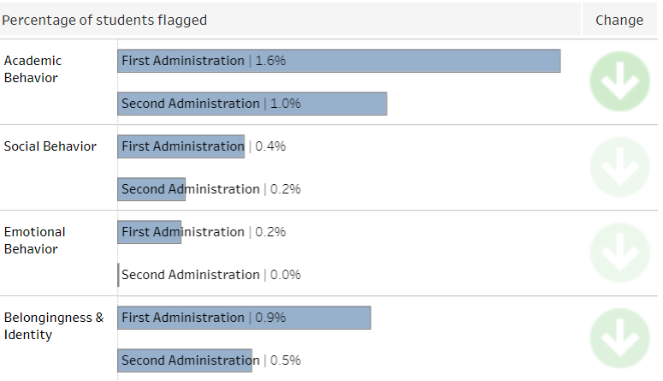
2022-23 CEE SWS Data (Continued)
Where do Manson students feel most safe?
Classrooms
Recess
Where do Manson students feel least safe?
Bathrooms
Parking Lots

Slide 5
BASC3/BESS Screener
Available in Spanish & English
Nationally norm-referenced & evidence based
Student survey + option for teacher & parent surveys
Short (28 questions…avg of 4-5 min to complete)
Informative (internalizing and externalizing factors)
CASEL (Collaborative for Academic, Social, and Emotional Learning) aligned
Utilized by school psychologists & other professionals
Similar questions & cost to CEE screener but improved data analytics & reports for staff

Slide 6
Sample of BASC3/BESS Questions
N = Never
S = Sometimes
O = Often
A = Always

Slide 7
Mental Health Updates
Manson Schools has partnered with CVCH since 2013-14 to provide school-based services
This school year, CVCH’s school-based provider supported 20+ K-12 Manson students on Wednesdays & Thursdays on site
The provider resigned their position in March
CVCH is now looking to fill 2 school-based positions…one has been posted for over a year
At least 10 Manson students (Grades 6-9) are currently on a waitlist for counseling
Waitlist times have increased from 3-6 months (Fall) to 6-12 months (Current)
Counseling Team continues to look for creative, reputable & stable mental health solutions (Catholic Charities, telehealth, etc)

Slide 8
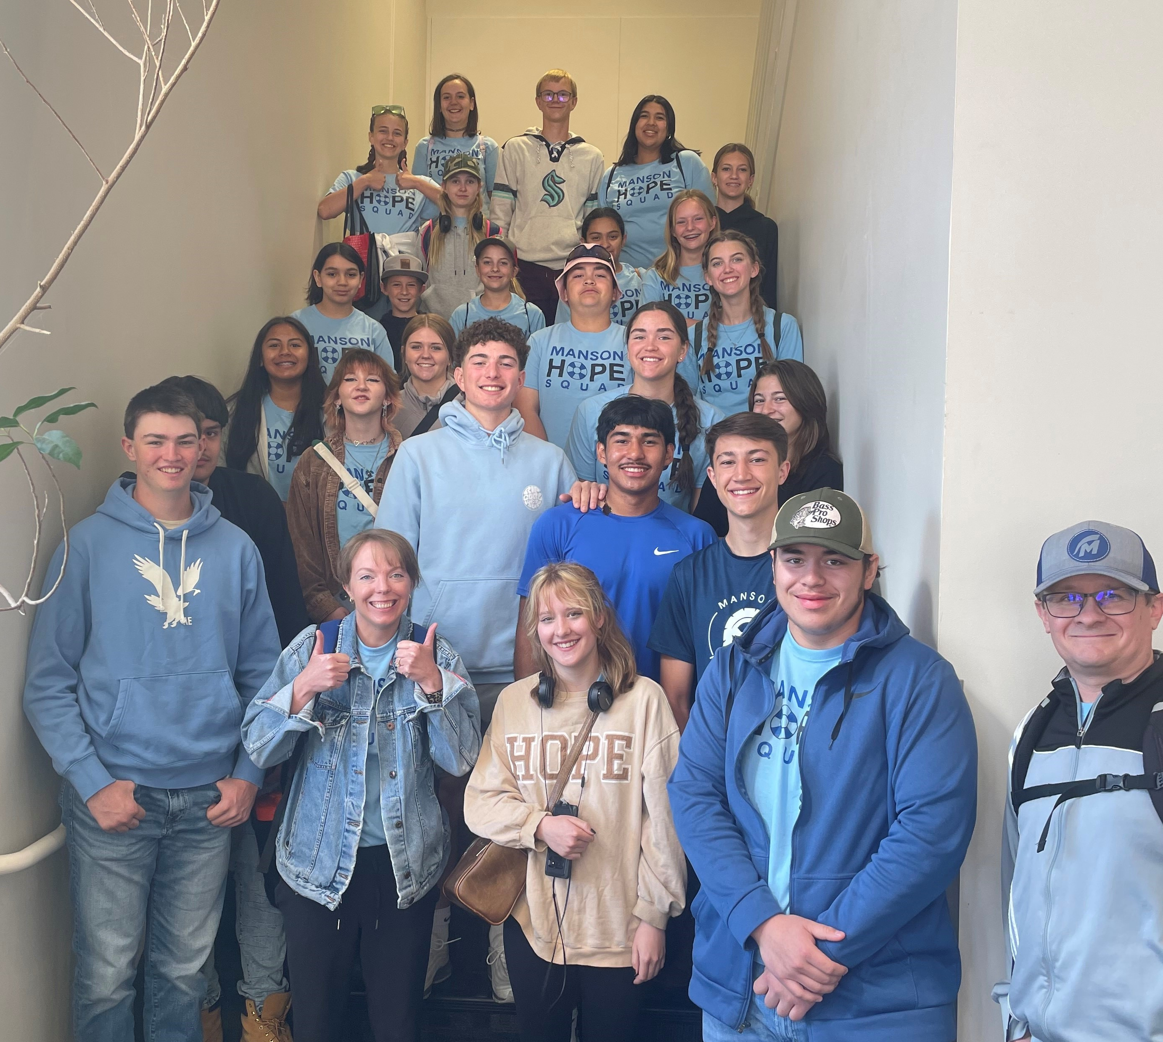
Manson Middle & High School Hope Squad
Hope Squad is a peer-to-peer suicide prevention program. Hope Squad members are nominated by their classmates as trustworthy peers and trained by advisors. The program reduces youth suicide through education, training, and peer intervention.

Slide 9
2022-23 Hope Squad Timeline
Nov 17: QPR Training for all Secondary Staff
Dec 6 & 7: Classroom Presentations & Student Nominations
January: Advisors review nominations & meet with students
February: Parent Meeting & Approval
March-June: Student Training & Meetings (Strong Time)
May: Regional Conference in Wenatchee
August: Hope Squad Retreat
September 2023: Full Hope Squad Implementation Begins

